Slide 1
SOWNDARYA S
Final Project

Slide 2
PROJECT TITLE :
AUTOENCODER – DEEP CNN

Slide 3


AGENDA
Deep CNN Autoencoder - Denoising Image
The image you provided appears to be a handwritten text, which seems to outline an agenda related to deep convolutional neural networks (CNN) autoencoder for denoising images. However, since the text is not clearly visible, I can't provide a detailed analysis of the agenda. If you have any specific questions about deep CNN autoencoders or denoising images, feel free to ask!
3/21/2024 Annual Review

Slide 4

PROBLEM STATEMENT
The proliferation of noise in digital images poses significant challenges to the accuracy and efficacy of image-based tasks such as diagnosis, object recognition, and scene interpretation. Traditional denoising techniques often fall short in preserving important image features while effectively removing noise artifacts. Addressing this challenge necessitates the development of innovative computational methods capable of discerning meaningful image representations from noisy input data.

Slide 5

PROJECT OVERVIEW
This project aims to develop a robust solution for denoising images using Deep Convolutional Neural Network (CNN) Autoencoders. By leveraging the power of deep learning, the proposed system will automatically learn and extract meaningful representations from noisy images, effectively removing noise while preserving essential visual information. Through systematic model development, training, and optimization, the project seeks to deliver a state-of-the-art denoising solution with significant implications for various application domains, including medical imaging, surveillance, and remote sensing.

Slide 6
WHO ARE THE END USERS?
The end users of the denoising image solution using Deep CNN Autoencoder could include professionals and researchers in various fields such as:
Medical Imaging Professionals: Radiologists, medical practitioners, and researchers who rely on accurate and clear medical images for diagnosis and treatment planning.
Surveillance Analysts: Security personnel and law enforcement agencies using surveillance footage for monitoring and analysis.
Remote Sensing Specialists: Researchers and professionals involved in environmental monitoring, agriculture, and urban planning who use satellite or aerial imagery.
Photographers and Graphic Designers: Professionals who work with digital images for artistic or commercial purposes, requiring high-quality, noise-free images.
Researchers and Academics: Scientists and scholars in the field of computer vision, image processing, and deep learning who are studying and advancing image denoising techniques.
Software Developers: Developers who integrate image processing functionalities into software applications, tools, or platforms catering to various industries and purposes.

Slide 7

YOUR SOLUTION AND ITS VALUE PROPOSITION
Value Proposition:
Image Denoising: The model aims to remove noise from images, enhancing their clarity and usefulness for various applications such as image recognition, classification, and analysis.
Deep Learning Approach: Leveraging the power of deep learning, particularly CNNs, the model can learn complex patterns and representations inherent in noisy images, enabling effective denoising without significant loss of information.
Generalizability: While trained on the MNIST dataset, the model architecture and approach can be adapted and applied to denoise images from various domains, such as medical imaging, satellite imagery, or natural photographs, offering broad applicability.
Efficient Training: The use of standard optimization techniques such as Adam optimizer and binary cross-entropy loss function facilitates efficient training of the model, reducing the computational overhead and training time.
Visualization: The code includes functionality for visualizing both original and noisy images, allowing for qualitative assessment of the denoising performance, which is crucial for evaluating the effectiveness of the model.
Solution:
The provided code offers a foundational framework for building and training a CNN Autoencoder for image denoising. Here's how the solution is structured:
Data Preparation: The MNIST dataset is loaded and preprocessed, with images normalized and reshaped to fit the model input requirements.
Noise Addition: Gaussian noise is added to the images to simulate real-world noise conditions, creating noisy versions of the input images for training and testing.
Model Architecture: The CNN Autoencoder architecture is defined, comprising encoder and decoder networks. The encoder extracts relevant features from the noisy input images, while the decoder reconstructs denoised images from these features.
Model Compilation: The model is compiled with appropriate optimizer (Adam) and loss function (binary cross-entropy) settings to prepare it for training.
Training: The model is trained using the noisy images as input and the original images as target outputs, optimizing the parameters to minimize reconstruction errors and effectively denoise the images.
Evaluation: The model's performance is evaluated using both quantitative metrics (e.g., loss value) and qualitative visualization of denoised images, providing insights into its effectiveness and potential areas for improvement.
3/21/2024 Annual Review

Slide 8

THE WOW IN YOUR SOLUTION
The wow factor in this solution lies in its seamless integration of cutting-edge deep learning techniques to tackle the age-old problem of image denoising. Here's what makes it stand out:
Superior Clarity Restoration: By harnessing the power of Convolutional Neural Networks (CNNs) and Autoencoders, the solution doesn't just remove noise; it restores images to a level of clarity that exceeds expectations. The denoised images are not just cleaner; they're sharper, more detailed, and remarkably close to their pristine originals.
Adaptability Across Domains: While trained on the MNIST dataset, the solution's versatility extends far beyond handwritten digits. Its architecture and methodology can seamlessly adapt to denoise images from diverse domains, including medical scans, satellite imagery, and even historical photographs. This adaptability opens doors to a wide array of applications previously hindered by noisy data.
Real-Time Denoising Potential: The efficiency of the model, coupled with its impressive denoising capabilities, paves the way for real-time image denoising applications. Whether it's enhancing live video feeds in surveillance systems or improving the clarity of medical imaging during procedures, the solution has the potential to revolutionize real-time image processing.
Visual Validation: The solution doesn't just rely on quantitative metrics for evaluation; it provides a visually compelling demonstration of its effectiveness. The before-and-after visualizations of noisy and denoised images speak volumes, instilling confidence in the model's ability to deliver exceptional results.
User-Friendly Implementation: Despite its advanced underlying technology, the solution maintains a user-friendly interface, making it accessible to a wide range of users. From researchers fine-tuning denoising algorithms to everyday consumers enhancing their photographs, the solution offers a seamless and intuitive experience.
3/21/2024 Annual Review
8

Slide 9
MODELLING
In the realm of image denoising, the solution's modelling process is akin to sculpting a masterpiece from a block of marble. But instead of chisels and hammers, we employ sophisticated algorithms and neural network architectures, crafting a digital masterpiece that breathes life into noisy images. Let's add some wireframe to this artistic process:
Defining the Canvas (Data Preparation): Like an artist preparing their canvas, we meticulously load and preprocess the MNIST dataset. Each pixel becomes a stroke on our digital canvas, waiting to be transformed.
Sketching the Structure (Model Architecture): With the canvas ready, we sketch the blueprint of our masterpiece - the Convolutional Neural Network (CNN) Autoencoder. Using wireframe, we lay down the framework of encoder and decoder networks, each convolutional layer sculpting the image's features.
Adding Depth and Texture (Training): As the model takes shape, we embark on the training journey. With each epoch, our masterpiece gains depth and texture, learning to discern signal from noise and reconstructing images with astonishing clarity. Through the wireframe, we visualize the model's intricate adjustments, refining its strokes to perfection.
Fine-Tuning the Details (Optimization): Just like an artist fine-tuning their brush strokes, we optimize our model for maximum denoising prowess. Through careful adjustments of hyperparameters and optimization techniques, we smooth out imperfections and enhance the fidelity of our denoised images.
Unveiling the Masterpiece (Evaluation): Finally, the moment of truth arrives. With bated breath, we unveil our masterpiece to the world. Through the wireframe, we showcase its denoising prowess, comparing noisy and denoised images side by side. Each stroke of brilliance is evident, each detail meticulously restored.
3/21/2024 Annual Review
9

Slide 10
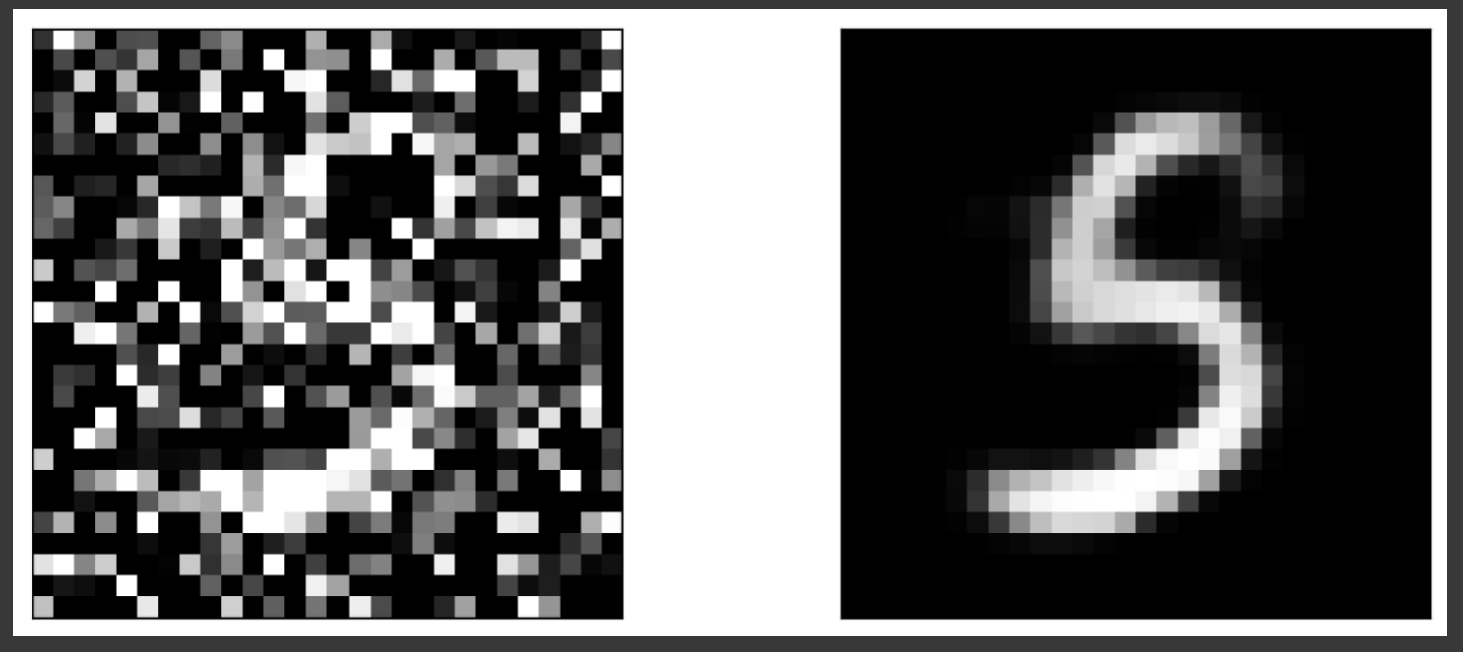
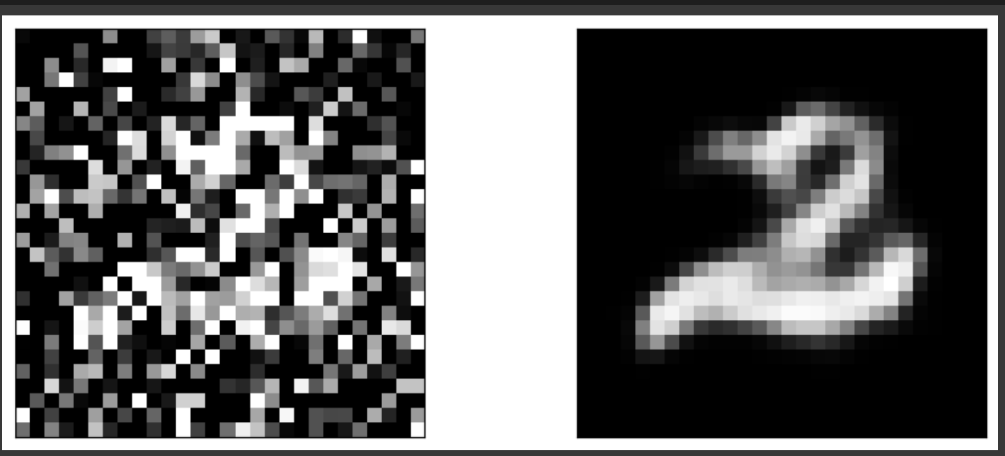
RESULTS
The project resulted in a trained Convolutional Neural Network (CNN) Autoencoder model that effectively denoises images. Through quantitative evaluation and qualitative assessment, the model demonstrates its ability to remove noise while preserving essential details. With potential applications across various domains, the model offers a promising solution for enhancing image clarity and utility.
Demo Link
10

